Slide 1

Mixed Criticality Scheduling
Name | Nader Yahia
Matriculation | 2210026
Supervisor | Prof. Dr.rer.nat. Stefan Henkler

Slide 2
Motivation
1. Coexistence of Different Criticality Levels
Modern embedded systems increasingly integrate functions with different levels of safety and importance on the same hardware platform:
Examples:
Automotive: Braking + Infotainment
Avionics: Flight Control + Passenger Services
Medical: Life-Support + Monitoring
The Challenge:
Guarantee deadlines for high-criticality tasks while efficiently utilizing system resources.

Slide 3

2. Classical RTS Pitfalls
Motivation
Fixed Priority (FP)
Earliest Deadline First (EDF)
Dynamic priorities based on deadlines
Optimal on a uniprocessor
Can achieve full processor utilization [2]
Static priorities assigned offline
Simple and predictable
Limited processor utilization [1]
Standard EDF treats all tasks equally.
EDF cannot distinguish task criticality.
HI-criticality deadlines may be jeopardized.
Can EDF be adapted to favor HI-criticality tasks before an overrun occurs?

Slide 4
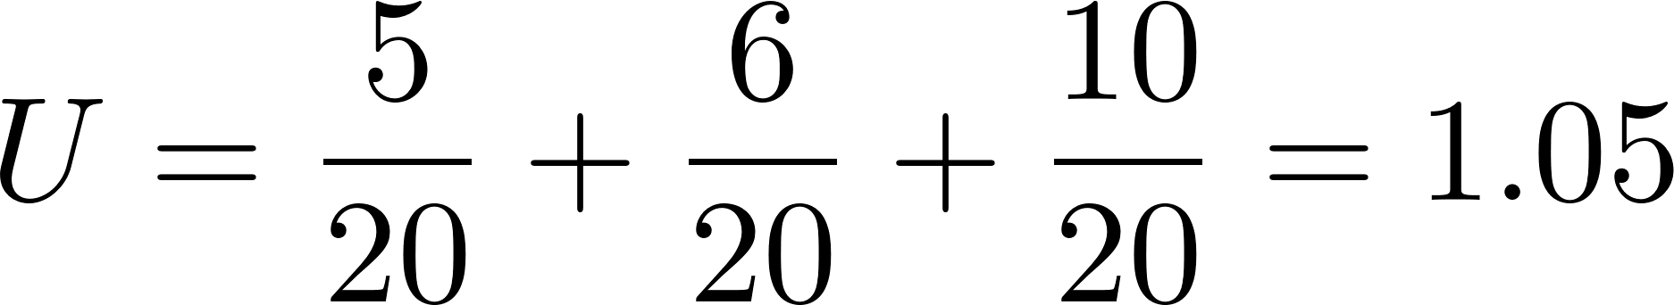
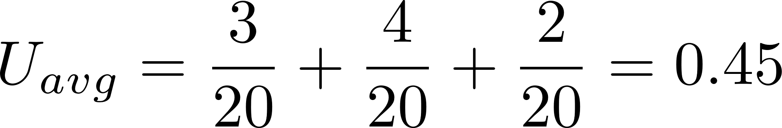
3. Single WCET Failure in Practice
Motivation
Task | Criticality | WCET (measured) | WCET (safe bound)
τ₁ (Braking) | High | 3 ms | 5 ms
τ₂ (Control) | High | 4 ms | 6 ms
τ₃ (Infotainment) | Low | 2 ms | 10 ms
T
20 ms
20 ms
20 ms
Total Utilization (Worst-Case Design):
System becomes unschedulable
Actual Execution Behavior:
System is actually heavily under-utilized
Worst-case design ensures safety infrequent overloads, but is often resource-inefficient in normal operation.

Slide 5
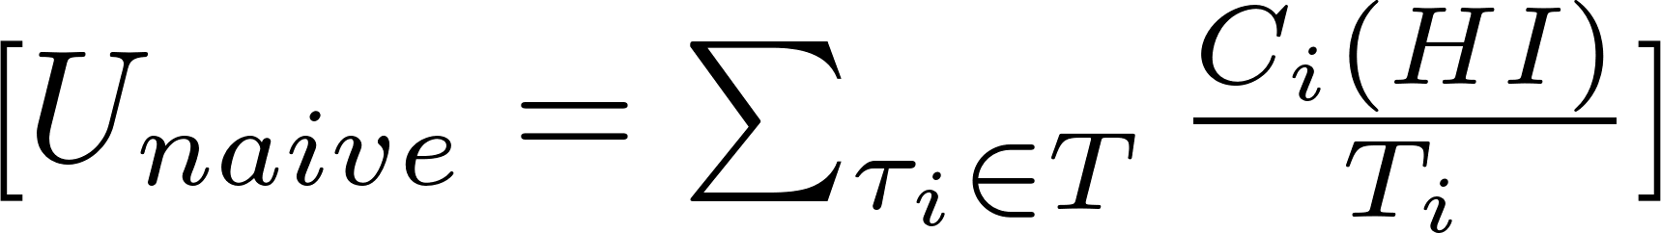
The Vestal Model
Using a single WCET for all tasks forces the system to be dimensioned using pessimistic execution-time bounds.
[3]
Vestal's Idea:
Two execution assumptions are maintained LO-mode and HI-mode
LO-mode
HI-mode
All HI meet deadlines
LO tasks suspended
All tasks meet deadlines.
HI tasks have two WCET bounds:
C_i(LO) for normal operation.
C_i(HI) for worst-case execution.

Slide 6
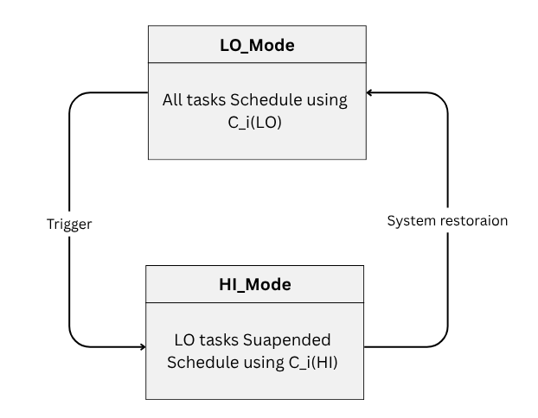
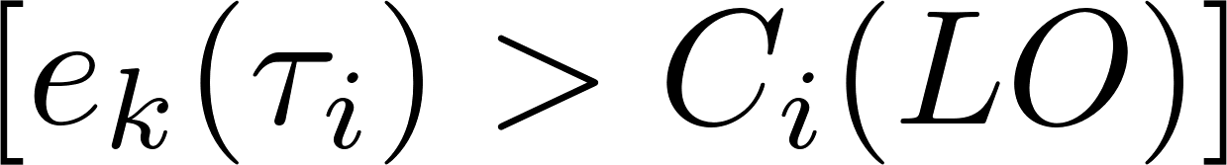
Mode Switching Concept
Normal Operation (LO-Mode):
All tasks execute using (C_i(LO)).
LO- and HI-criticality tasks are scheduled.
System assumes nominal execution behavior
Mode Switch Trigger:
A HI-criticality task exceeds its LO-mode budget
[3]
HI-Mode Operation:
System transitions to HI-mode.
HI-criticality tasks receive execution up to (C_i(HI)).
LO-criticality tasks may be suspended.
Scheduler prioritizes maintaining HI-criticality guarantees.

Slide 7
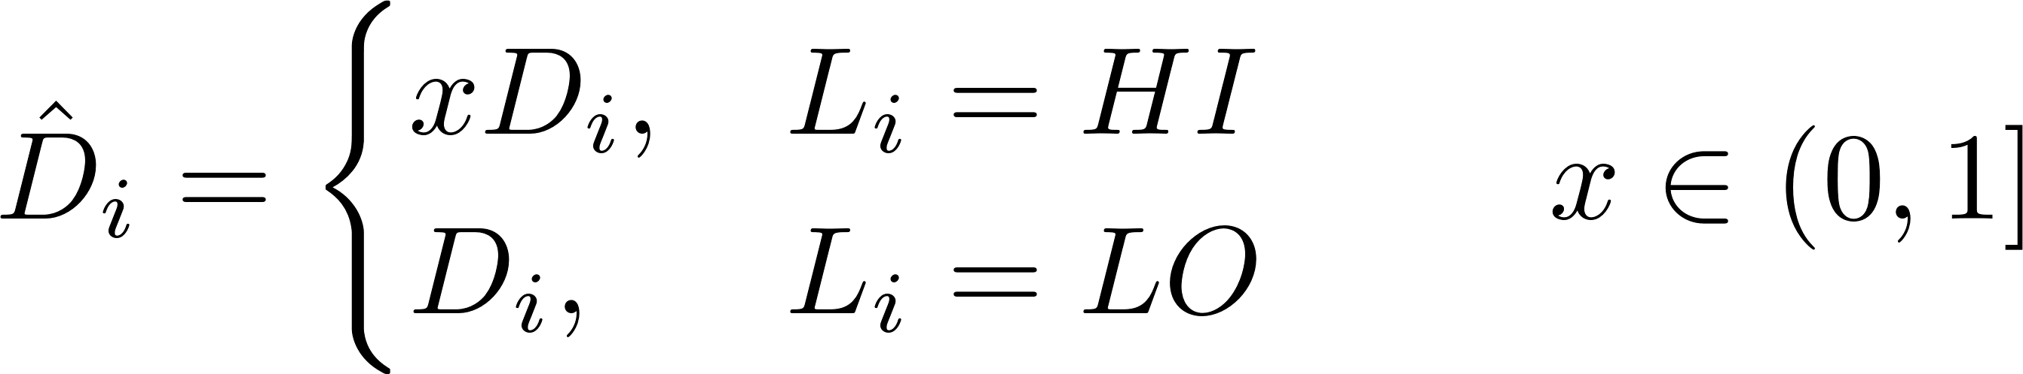
EDF with Virtual Deadlines (EDF-VD)
Main Idea
Give HI-criticality tasks earlier scheduling deadlines:
[5]
LO-Mode
All HI and LO tasks execute.
HI tasks use compressed (VD).
Execution times Ci_(LO) used.
HI-Mode
when a HI task exceeds Ci_(LO)
LO tasks (suspended), HI continue.
true deadlines Di​ and uses Ci_(HI)
EDF-VD preserves HI-criticality guarantees while improving utilization compared to naive EDF.

Slide 8
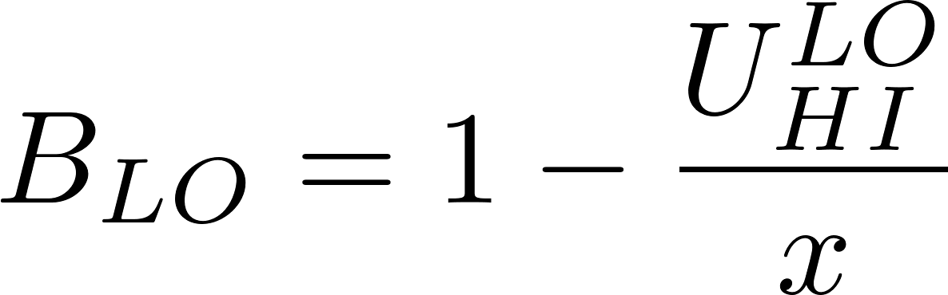
Tradeoffs
1. Safety vs Efficiency
Increasing HI protection reduces available LO execution time.
Decreasing protection risks HI-task deadline misses.
Safety-First | Efficiency-First
HI task: C(LO)=4 ms , C(HI)=10 ms. | HI task: C(LO)=4 , C(HI)=10 ms.
Scheduler reserves full 10 ms. (6ms) | Scheduler allocates only 4 ms.
HI-task deadlines guaranteed. | More processor time available for LO.
High safety, lower resource utilization. | High utilization, lower safety margin.
Role of the Compression Factor x
Small x: higher HI safety, lower LO capacity.
Large x: higher LO efficiency, lower HI safety margin.
[5]
X=0.5
Safety
Efficiency

Slide 9
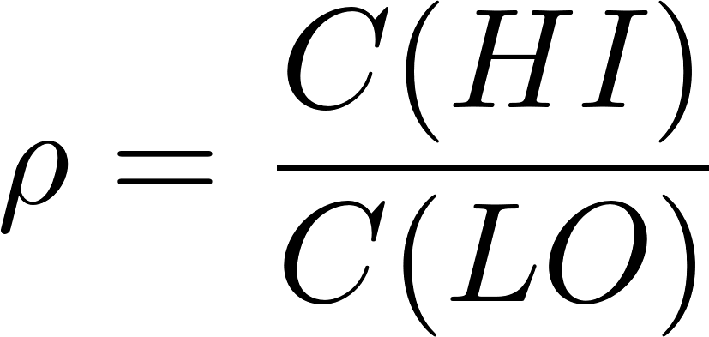
2. WCET Pessimism vs Utilization
Tradeoffs
HI WCETs are conservative by design.
Actual execution is typically much smaller.
Leads to unused reserved capacity (“pessimism tax”).
Criticality Augmentation Factor
[5]
Measures how larger the certified WCET is than the nominal WCET.
Industrial benchmarks range from 1.5× to 10×.
ρi​ (Aug.Factor) | Utilization | LO bandwidth loss
1.5× | 1.5× | 33% of HI-reserved bandwidth wasted
3× | 3× | 67% of HI-reserved bandwidth wasted
5× | 5× | 80% of HI-reserved bandwidth wasted
10× | 10× | 90% of HI-reserved bandwidth wasted

Slide 10
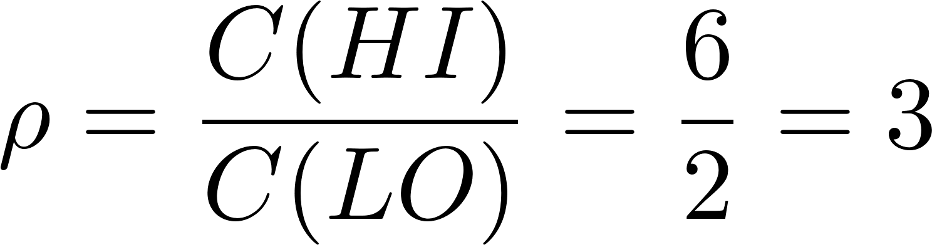
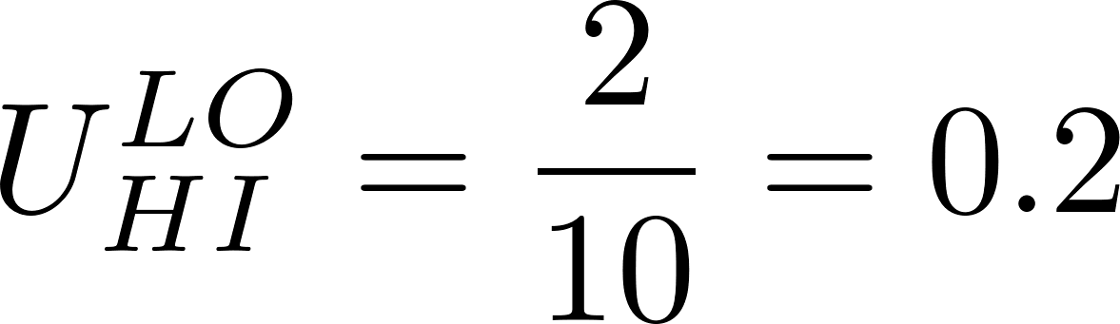
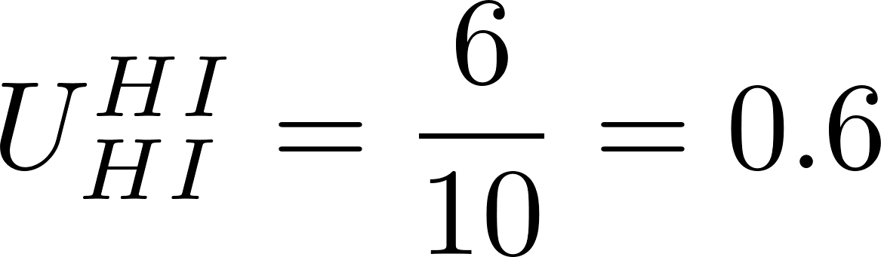
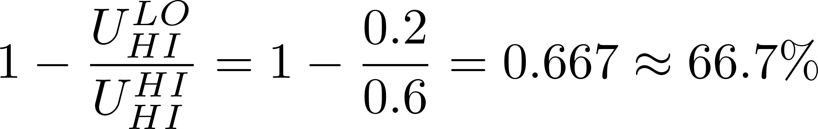
Tradeoffs
2. WCET Pessimism vs Utilization
EDF-VD balances this via compression factor x.
We have one HI-criticality task:
Period = 10 ms
C(LO)=2 ms
C(HI)=6 ms
HI-task utilization under LO assumptions
HI utilization reserved
Unused Reserved Fraction

Slide 11

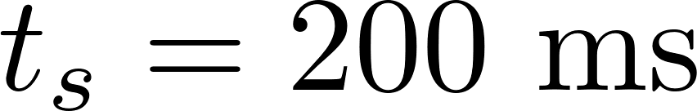
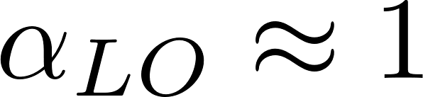
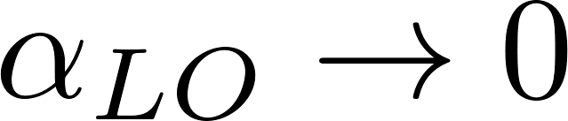
Tradeoffs
3. LO-Task Degradation
When a HI-criticality task exceeds its LO budget:
System enters HI-mode
LO-criticality tasks are suspended
Processor capacity is reserved for HI-criticality tasks
HI-task deadlines remain protected
Example
,
Therefore, LO tasks receive no service for 800 ms.
LO Availability
Normal Operation
Frequent Overruns
[7]

Slide 12
Limitations
Requires correct WCET bounds (non-trivial in practice)[6].
Hard to guarantee in modern architectures
Cache hit or miss & speculation affect validity
LO tasks may be suspended for long durations [3].
No formal LO-service guarantees in HI-mode [3].
Theory assumes a single-core processor [4].
Multicore introduces shared resource interference.
WCET and schedulability guarantees may break.
Practical scalability limits [4]
Multiple criticality levels increase complexity.
Formal analysis becomes computationally expensive.
Notes:
More tasks → more schedulability calculations.
More criticality levels → more mode-switch scenarios to analyze.
More cores → shared cache and memory interference become harder to predict.
More complex hardware → WCET analysis becomes increasingly difficult.

Slide 13
Conclusion
Mixed-Criticality Scheduling provides a formal framework to handle systems with heterogeneous safety requirements under shared computational resources.
Core system behavior is governed by a fundamental tension between:Safety guarantees vs. resource efficiencyWCET pessimism vs. practical utilizationHI-task correctness vs. LO-task service degradation
The analysis shows that system correctness is achieved through mode separation and controlled LO-task suspension, rather than uniform guarantees across all tasks.
However, key limitations remain in:WCET uncertainty and hardware dependenceLO-task starvation under sustained overloadExtension challenges for multicore systems
[7]

Slide 14
References
[1] C. L. Liu and J. W. Layland, “Scheduling algorithms for multiprogramming in a hard-real-time environment,” J. ACM, vol. 20, no. 1, pp. 46–61, Jan. 1973, doi: 10.1145/321738.321743.
[2] G. C. Buttazzo, Hard Real-Time Computing Systems: Predictable Scheduling Algorithms and Applications, 4th ed. Cham, Switzerland: Springer, 2020.
[3] S. Vestal, “Preemptive scheduling of multi-criticality systems with varying degrees of execution time assurance,” in Proc. IEEE Real-Time Systems Symposium (RTSS), 2007, pp. 239–243.
[4] S. Baruah, A. Burns, and R. I. Davis, “Response-time analysis for mixed-criticality systems,” in Proc. IEEE Real-Time Systems Symposium (RTSS), 2011.
[5] S. Baruah, V. Bonifaci, G. Buttazzo, and A. Marchetti-Spaccamela, “Mixed-criticality scheduling of sporadic task systems,” in Proc. Euromicro Conf. Real-Time Systems (ECRTS), 2011, pp. 1–12.
[6] R. Wilhelm et al., “The worst-case execution-time problem—overview of methods and survey of tools,” ACM Transactions on Embedded Computing Systems, vol. 7, no. 3, pp. 1–53, 2008, doi: 10.1145/1347375.1347389.

Slide 15
References
[7] 2210026, “AI Usage Protocol for All Milestones: Mixed Criticality Scheduling,” 2026. [Online]. Available: ai_usage_protocol_2210026_All_Milestones.json. Accessed: 2026.

Slide 16
Q & A

Slide 17
Assumptions
Assumption | Name | Description
A1 | Single-Core Processor | All tasks execute on a single processor.
A2 | Preemptive Scheduling | Tasks can be interrupted at any time.
A3 | Deterministic WCET Bounds | (C_i(LO)) and (C_i(HI)) are assumed to be safe upper bounds.
A4 | Periodic/Sporadic Tasks | Tasks are released periodically or with a minimum inter-arrival time (T_i).
A5 | Two-Level Criticality | Tasks are classified only as LO or HI criticality.
A6 | Negligible Overhead | Scheduling and mode-switch overhead are assumed small compared to execution times.

Slide 18
Assumptions
Assumption | Name | Description
A1 | Single-Core Processor | All tasks execute on a single processor.
A2 | Preemptive Scheduling | Jobs may be preempted at any instant.
A3 | Task Independence | Tasks are independent and do not share synchronization objects.
A4 | Deterministic WCET Bounds | The values (C_i(LO)) and (C_i(HI)) are assumed to be safe upper bounds.
A5 | Periodic/Sporadic Activation | Tasks are released periodically or sporadically with minimum inter-arrival time (T_i).
A6 | No Resource Sharing | No semaphores, mutexes, or shared I/O resources are considered.
A7 | Instant Mode Switch Detection | Mode switch from LO to HI is assumed to be detected without delay.
A8 | Negligible Runtime Overhead | Scheduling, monitoring, and context-switch overheads are assumed small compared to WCET.
A9 | Two-Level Criticality Model | Tasks are classified only into LO and HI criticality levels.

Slide 19
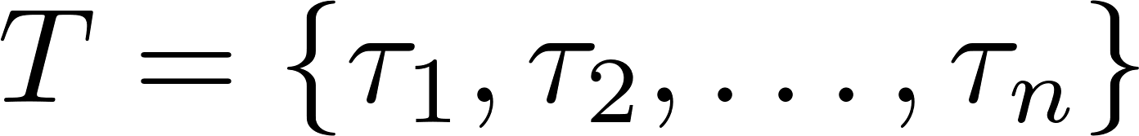
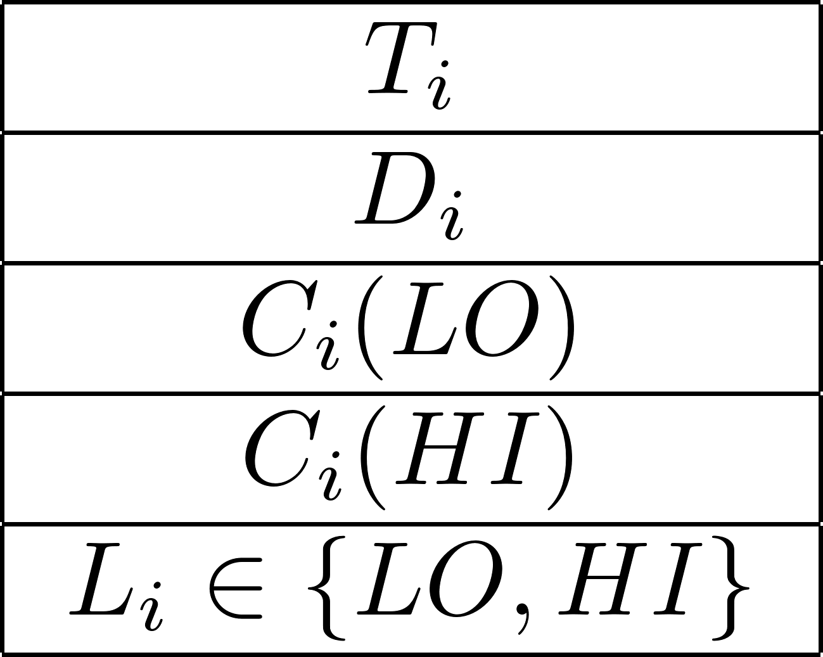
System Model
The system consists of a set of sporadic/periodic tasks:
Each τᵢ is defined as:
period (minimum inter-arrival time between task releases).
relative deadline, with Dᵢ ≤ Tᵢ .
execution time under low-assurance analysis.
execution time under high-assurance analysis.
[4]
task criticality level.
Each high-criticality task is modeled with two execution budgets:
optimistic (LO) estimate.
conservative (HI) certification-bound estimate.
Analyze how mixed-criticality scheduling maintains safety under execution overruns while improving processor utilization.

Slide 20
Note
Same phenomenon appears at different abstraction levels in real-time systems: scheduling policy, execution-time analysis, numerical utilization, and runtime behavior. Each slide isolates one of these perspectives to avoid mixing concepts in a single view.
The first slide focuses on the design-level tradeoff between safety and efficiency using the compression factor x.
The second slide explains the analytical cause, namely WCET pessimism and why reserved capacity is not fully used.
The third slide translates this into a quantitative utilization loss, showing how much capacity is wasted in practice.
The fourth we moved to the runtime perspective, where mode switching leads to LO degradation and guarantees remain only for HI-criticality tasks.”

